Slide 1
Model Order Reduction
Based on Proper Generalized Decomposition (PGD)
Rojan Saghian
March 2013

Slide 2
PGD: A way to circumvent the Curse of Dimensionality
Today many problems in science and engineering remain intractable because of their numerical complexity or the restriction imposed by different requirements (real-time).

Slide 3
So, Mesh-based methods are not suited
Another method is required to deal with highly multidimensional models, a mathematical tool in order to reduce the complexity of the model.
Proper Generalized Decomposition (PGD)
(Based on a separated representation of the solution)

Slide 4
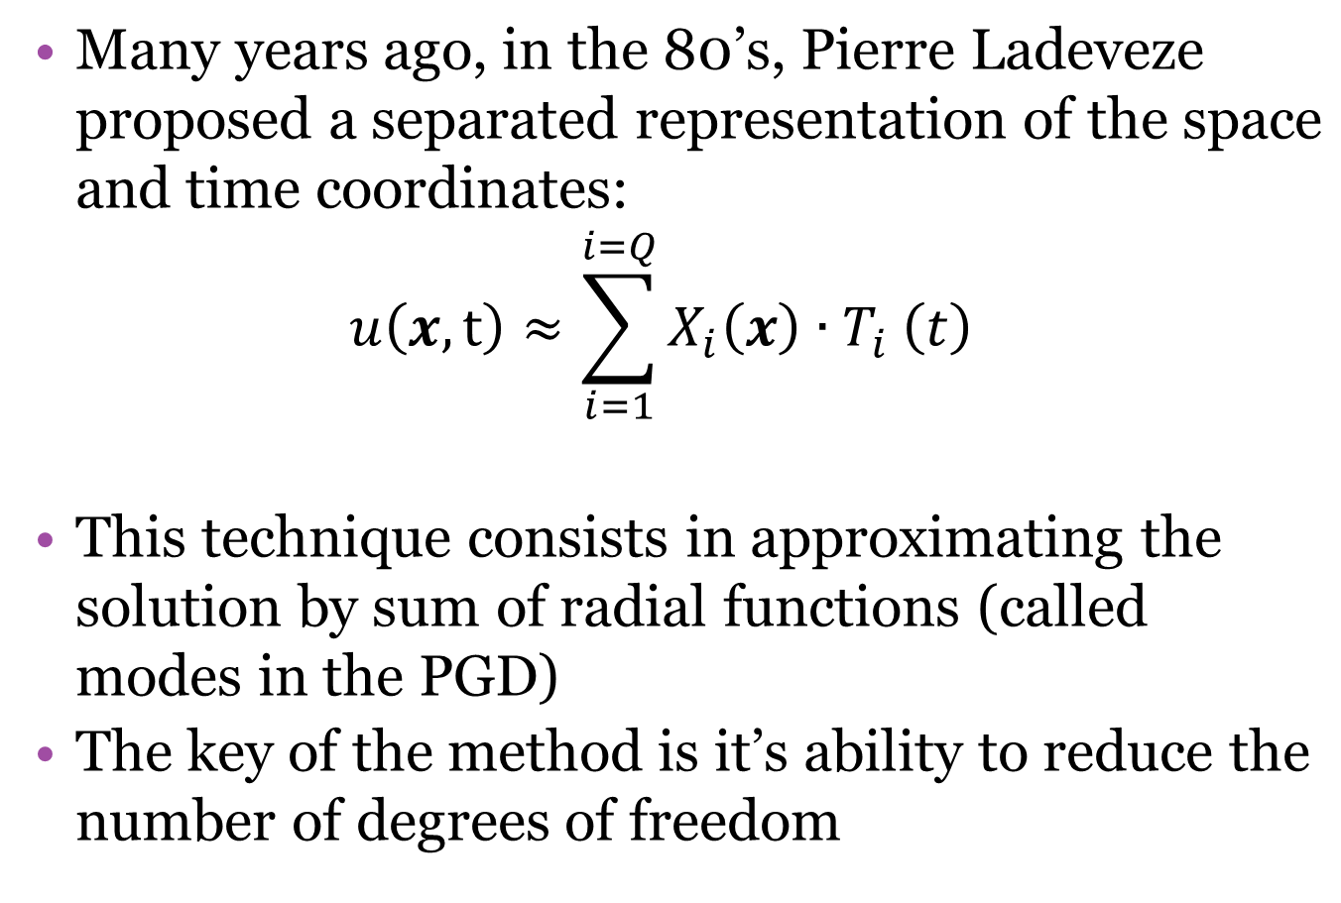
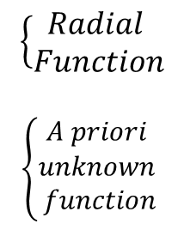

Slide 5
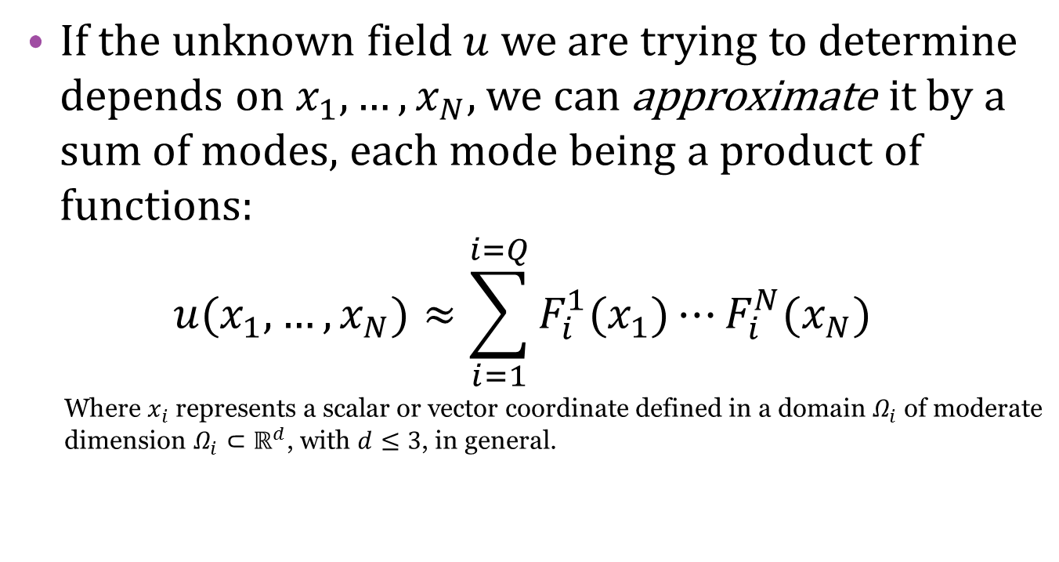
General From of the Separated Representation involved in PGD

Slide 6
Steps to Applying PGD
The idea is to introduce the separated representation of a priori unknown solution into the weak form of the problem. (by this, PGD break up the N multi-dimensional problem into N discretized problem which are easy to solve by existing techniques)
An alternating direction fixed point algorithm should be used
Then Galerkin formulation or Minimization of the Residual can be implemented

Slide 7
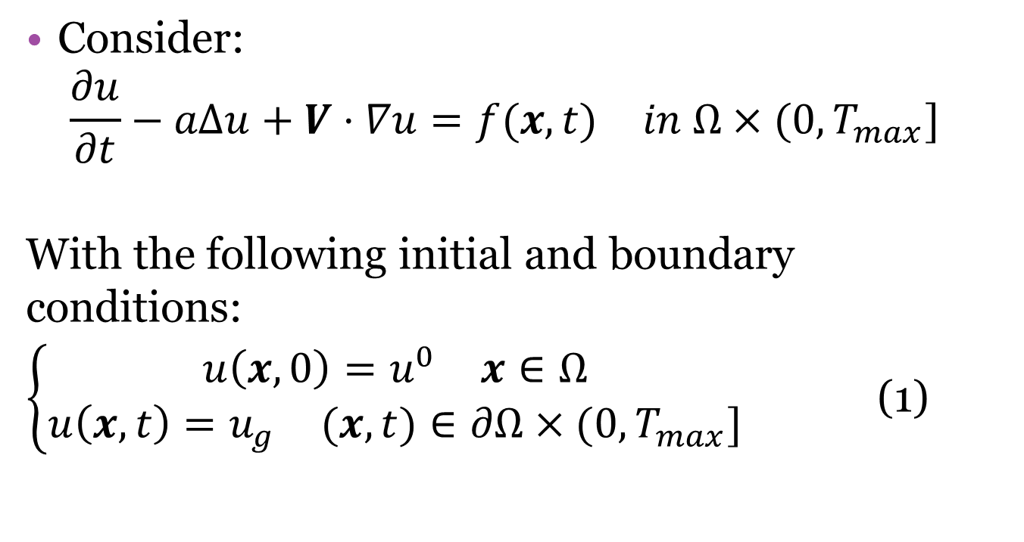

Example for Illustrating the PGD
Notes:
a=constant coefficient
v=the velocity field
𝛺⊂ℝ^𝑑 𝟏≤𝒅≤𝟑 , 𝑻_𝒎𝒂𝒙>𝟎

Slide 8
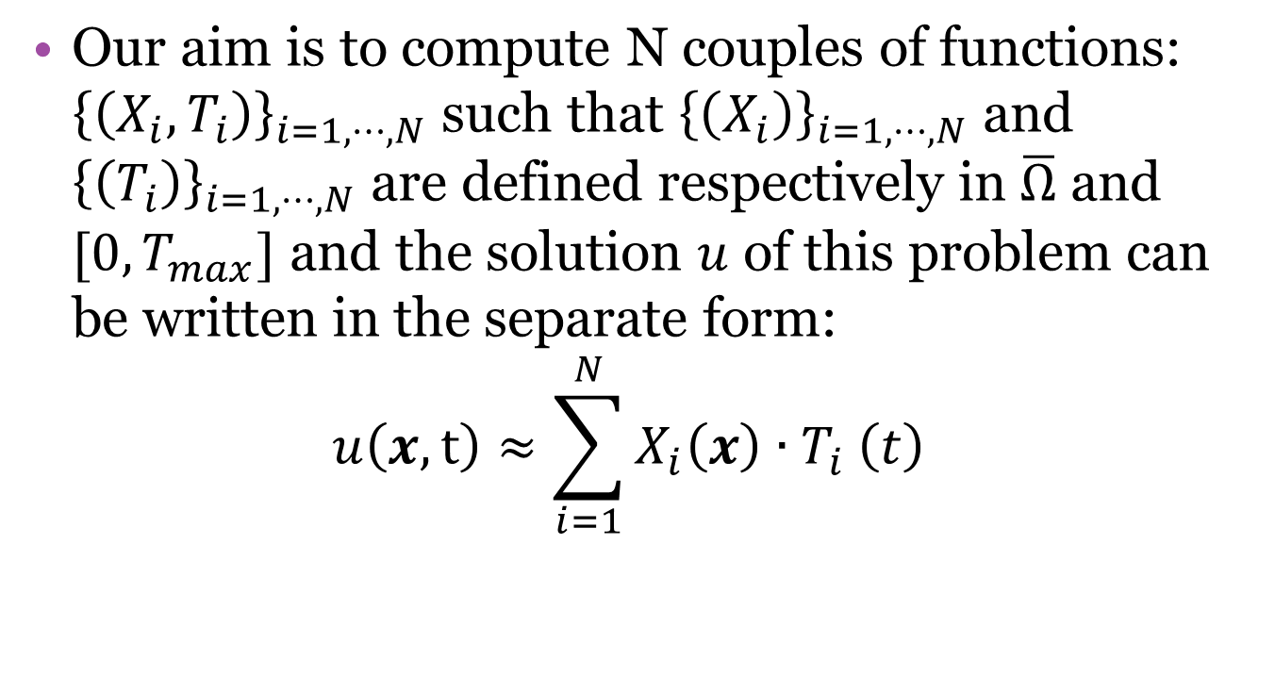

Slide 9
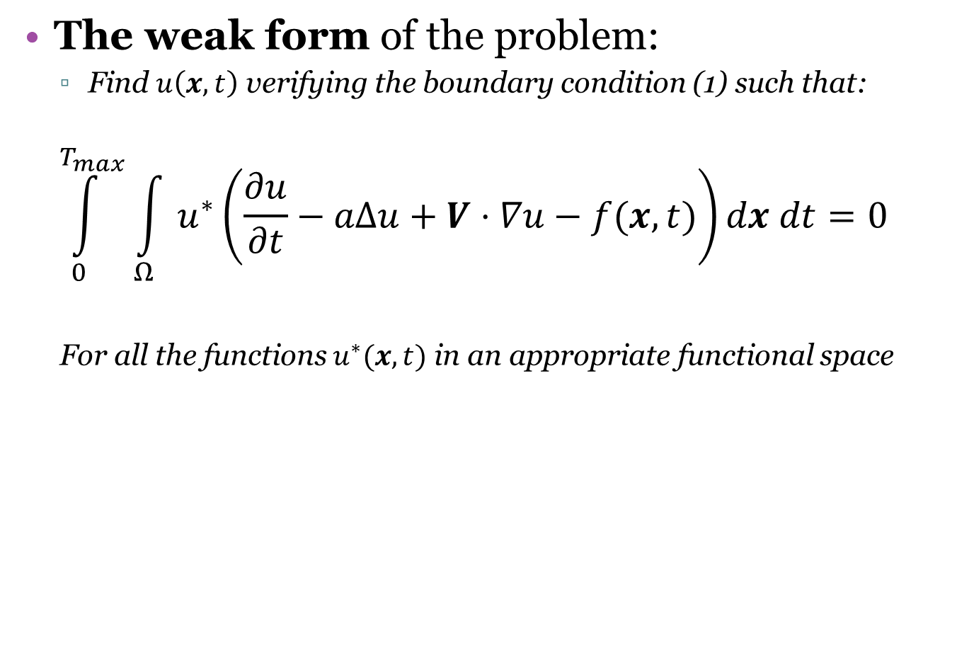
Weighting Function

Slide 10
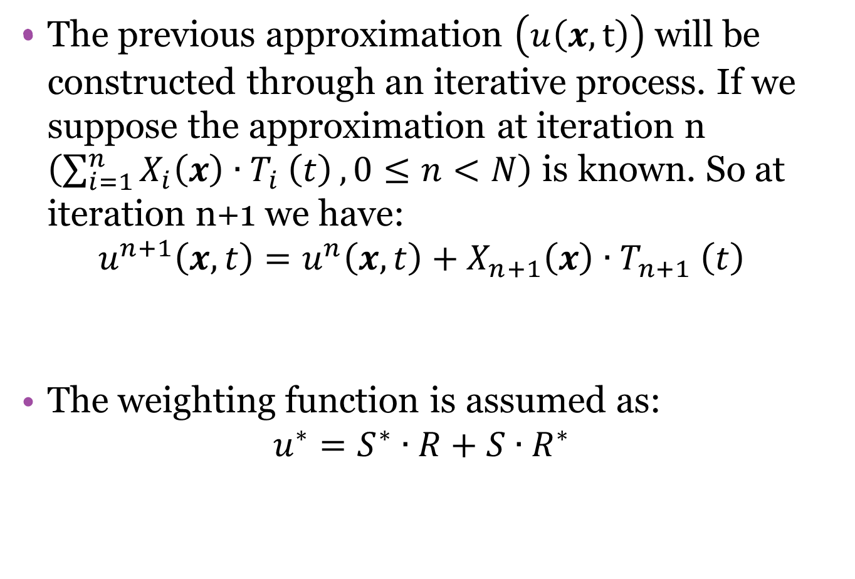

Notes:
𝛿𝑢=𝛿𝑆∙𝑅+𝑆∙𝛿𝑅

Slide 11
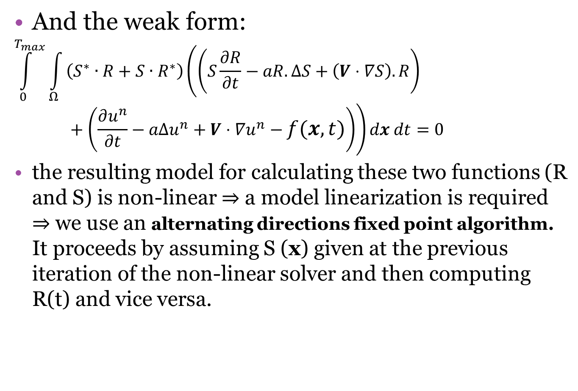

Slide 12
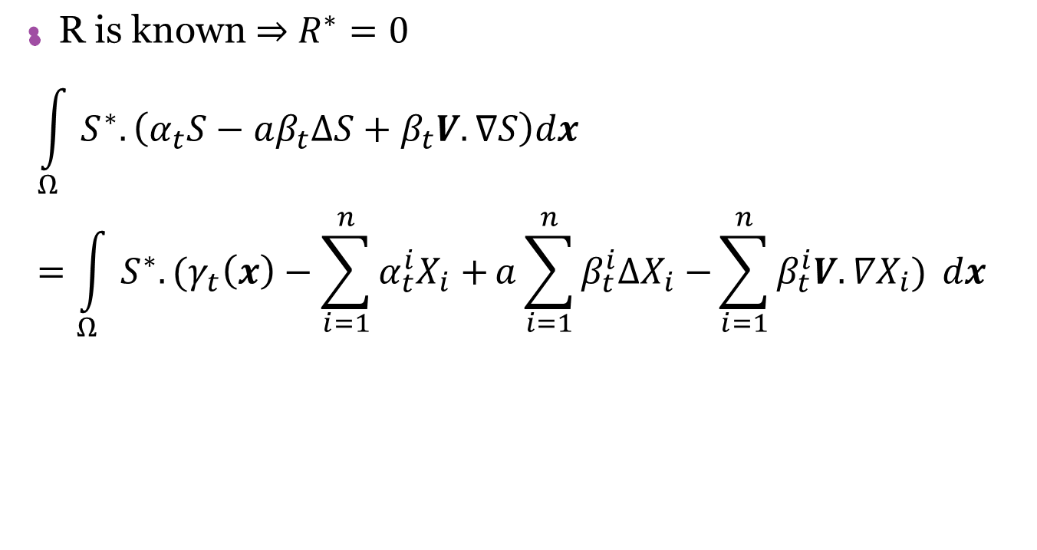
Computing S(x):

Slide 13
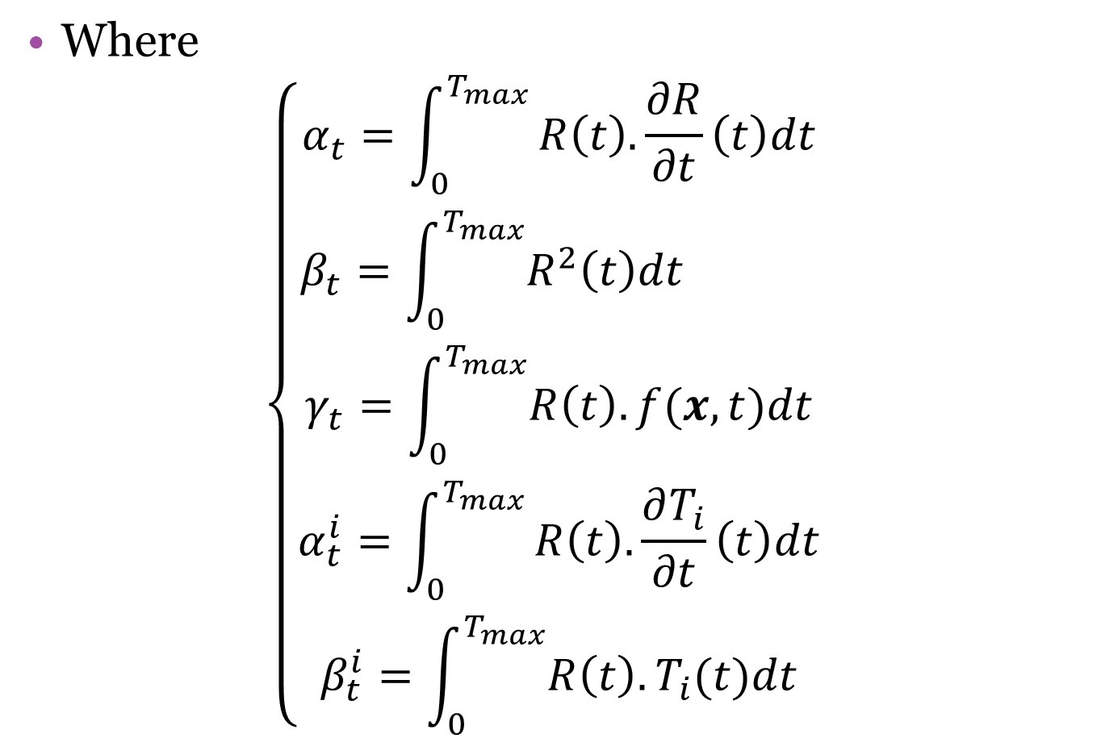

Slide 14
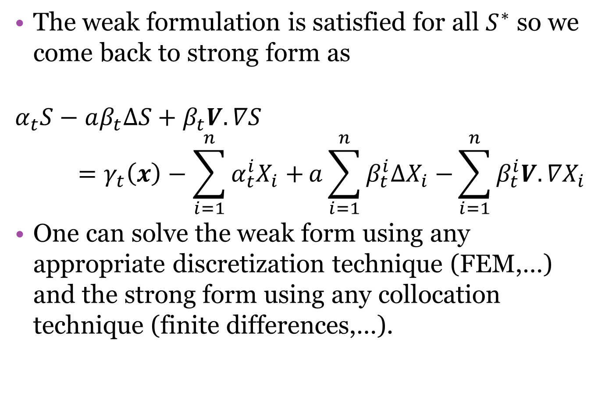

Slide 15
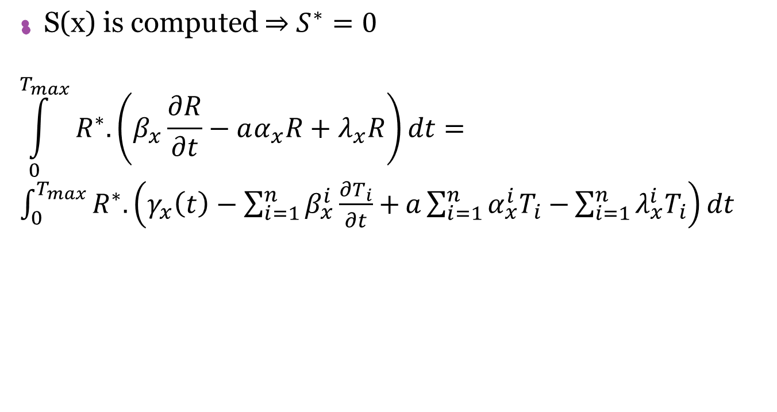
Computing R(t):

Slide 16
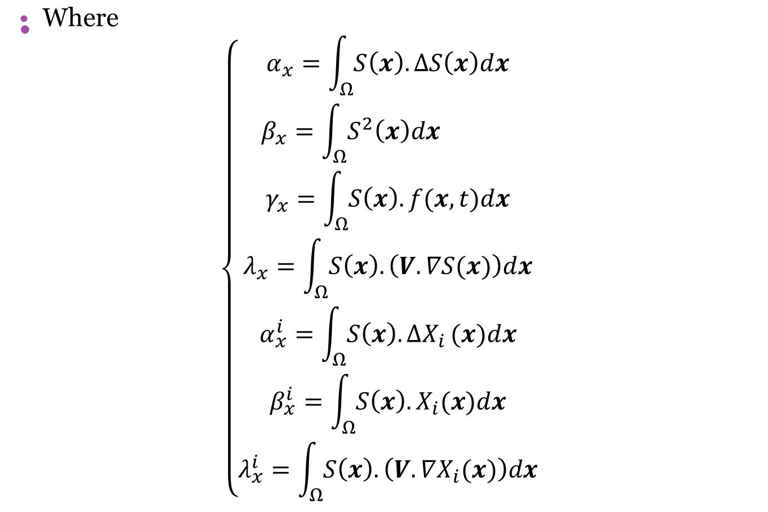

Slide 17
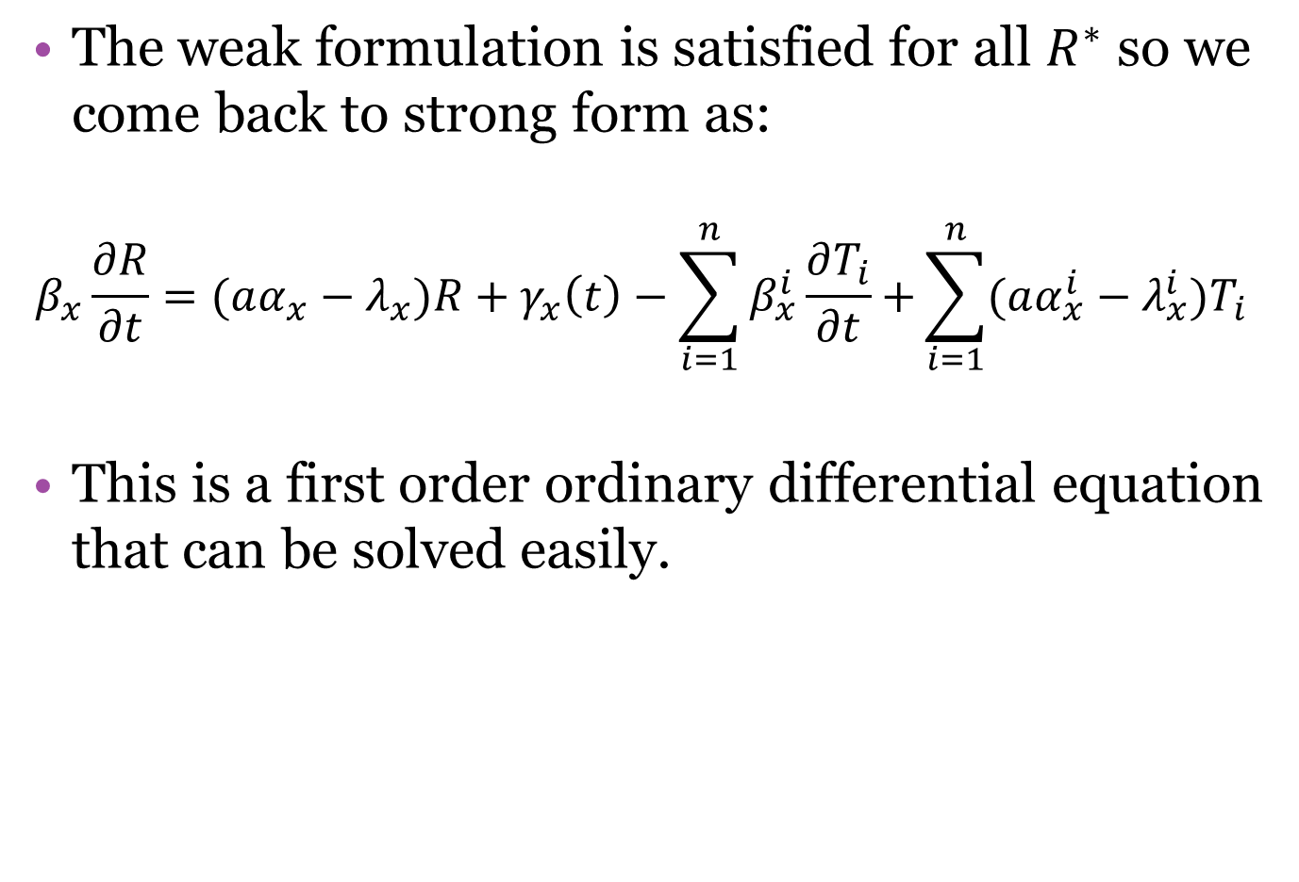

Slide 18
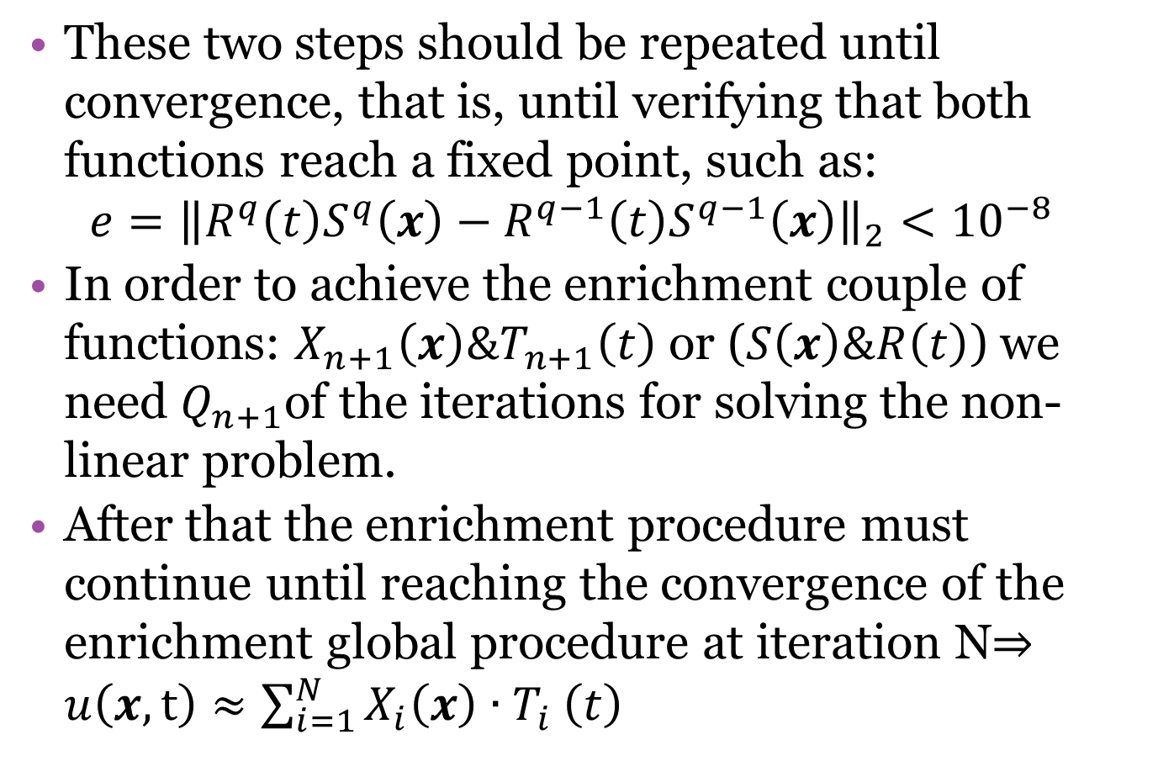

Slide 19
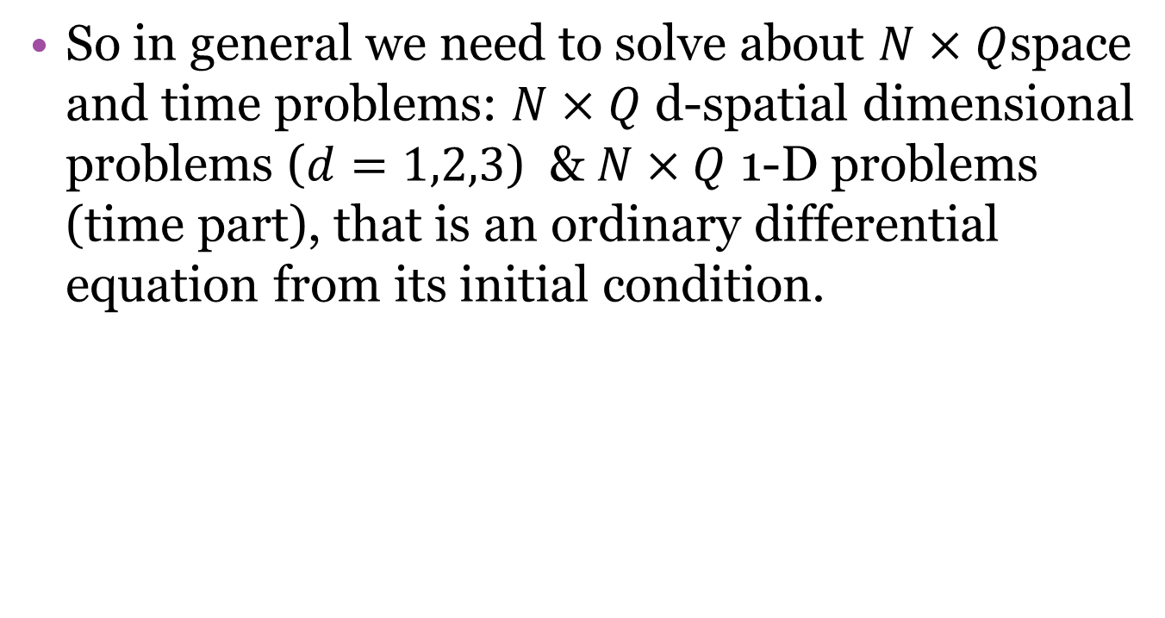

Slide 20
References
A short review on Model Order Reduction Based on Proper Generalized Decomposition, F.Chinesta, P.Ladeveze, E.Cueto, Arch Compute Methos Eng (2011) 18:395-404
Recent Advances and New Challenges in the Use of the Proper Generalized Decomposition for Solving Multidimensional Models, Chinesta, Francisco1; Ammar, Amine2; Cueto, Elías3, Archives of Computational Methods in Engineering, Volume 17, Number 4, December 2010 , pp. 327-350(24)
Advanced Numerical strategies for fast solution of transient problems, F.Poulhaon, a master thesis inn Computational Mechanics
On the deterministic solution of multidimensional parametric models using the Proper Generalized Decomposition E. Pruliere1, F. Chinesta2,3, A. Ammar, HAL : hal-00704427, version 1
Circumventing Curse of Dimensionality in the Solution of Highly Multidimensional Models Encountered in Quantum Mechanics Using Meshfree Finite Sums Decomposition Amine Ammar1and Francisco Chinesta, Lecture Notes in Computational Science and Engineering Volume 65, 2008, pp 1-17
Model reduction based on Proper Generalized Decomposition for the Stochastic steady incompressible Navier-Stokes equations Tamellini, L.; Le Maitre, O.; Nouy, A. MOX–Report No. 26/2012

Slide 21

